Slide 1

History of Windows OS
From Windows 1.0 to Windows 8.0
Borislav Varadinov
Technical Trainer

Slide 2


Table of Contents
MS-DOS
Windows 1.0,2.0.3X
Windows NT
Windows 9x
Windows XP
Windows Vista
Windows 7
Windows 8

Slide 3
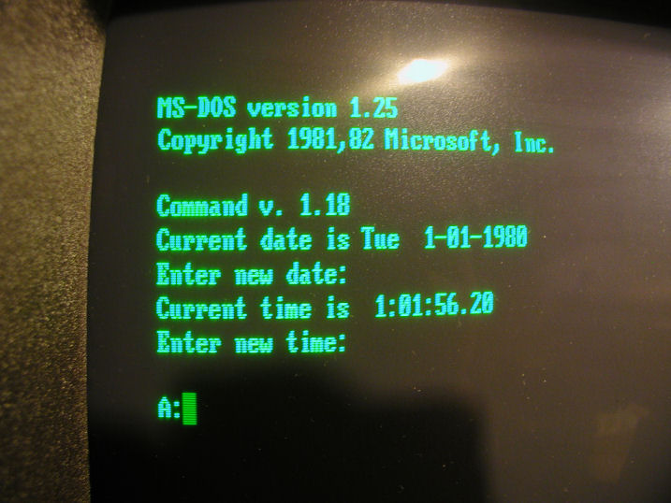
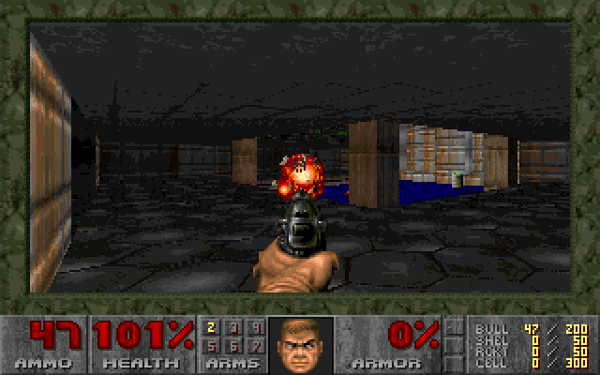

MS-DOS

Slide 4
MS-DOS (2)
MS DOS == Microsoft Disk Operating System
The main operating system for IBM PC
Single user and single process
Command line interface
Programmed in Assembly
3D Graphics programs
Gaming Industry and MS-DOS

Slide 5
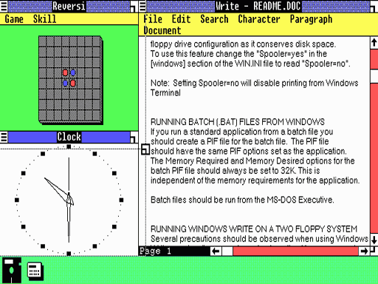
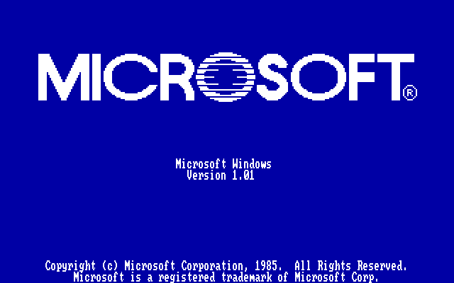
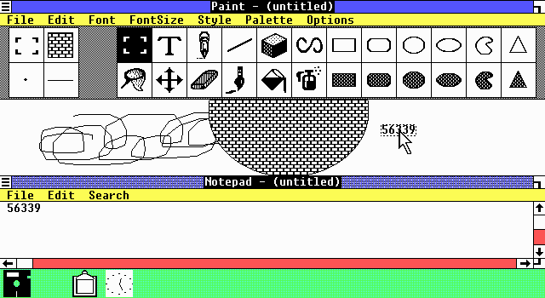
Windows 1.0

Slide 6
Windows 1.0 (2)
Released on November 20, 1985
NOT a complete operating system
But rather an "operating environment" that extended MS-DOS
Multitasking operating environment
The first user interface-based operating environment on the IBM PC platform
Tiled windows

Slide 7
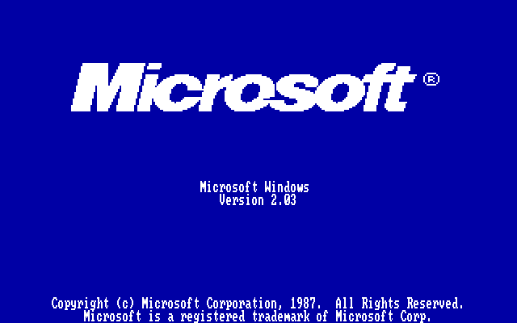
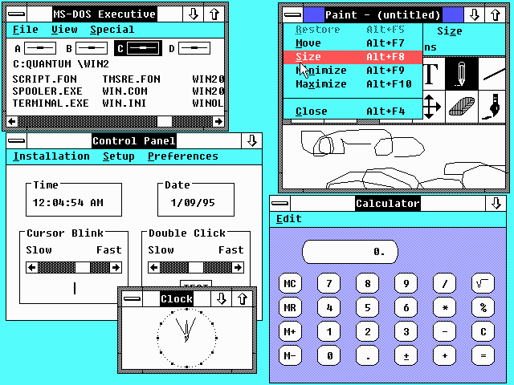
Windows 2.0

Slide 8
Windows 2.0 (2)
Overlapping Windows
Could access 1 megabyte of memory
Word and Excel are born
Terminology of “Minimize” and “Maximize”
Third-party developer support for Windows increased

Slide 9
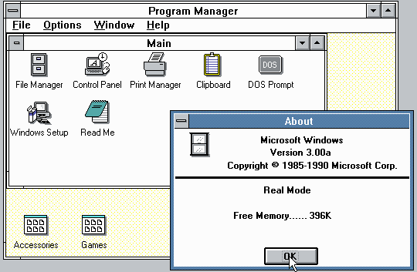
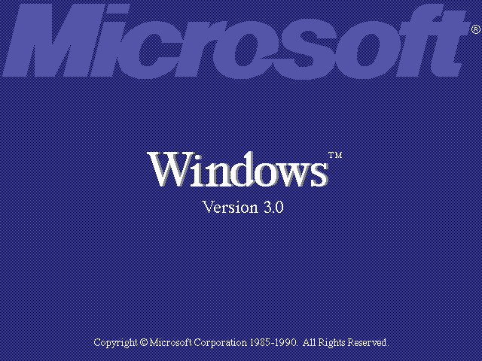
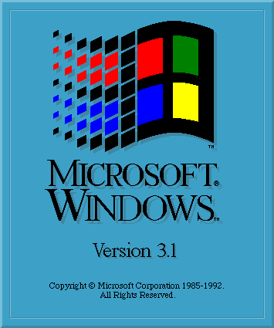
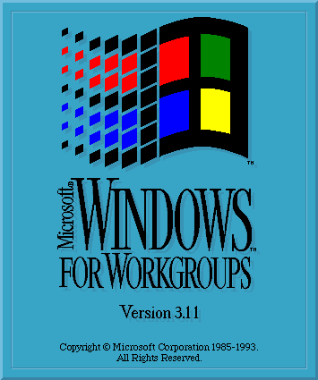
Windows 3.X

Slide 10
Windows 3.X
Windows Registry
SMB Sharing
Internet Explorer and Notepad
VGA video cards support (254 colors)
Multimedia
Native networking support

Slide 11
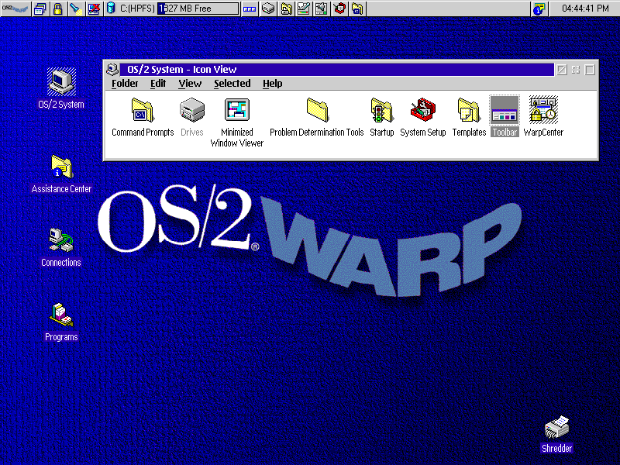
OS/2
Initially created by Microsoft and IBM
OS/2 1.0 was announced in April 1987
Second-generation IBM personal computers (PS/2)
HPFS file system
Many new features
IBM-Microsoft Breakup (1990)
IBM – OS/2 Business oriented

Slide 12
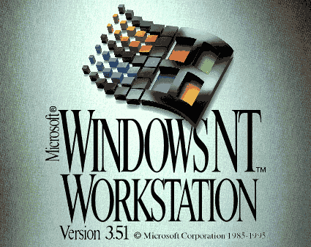
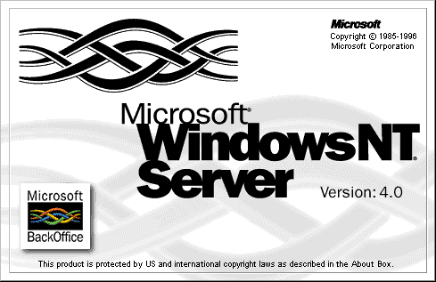
Windows NT

Slide 13
Windows NT
New 32-bit OS not depending on DOS!
High-level language based (C,C++)
Hardware and software portability
Multi User
Multi Tasking
Features comparable to Unix
DOS Virtual Machine for partial compatibility
Journaled and secure file system (NTFS)
Client and Server versions

Slide 14
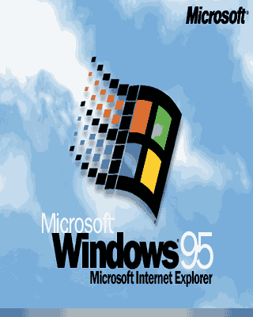
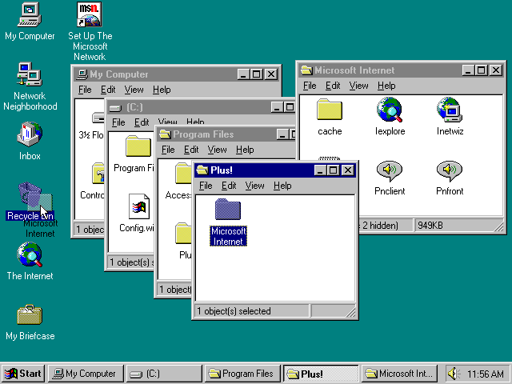
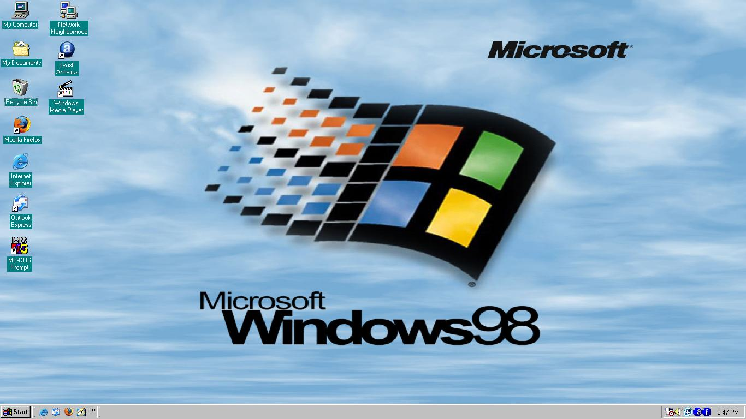
Windows 9X

Slide 15
Windows 9X (2)
Series of Windows operating systems based on the Windows 95 kernel
Predominantly known for its use in desktops market
Single user
Plug and Play hardware support and drivers (e.g. USB, Sound, Printers, Scanners)
Outlook Express

Slide 16
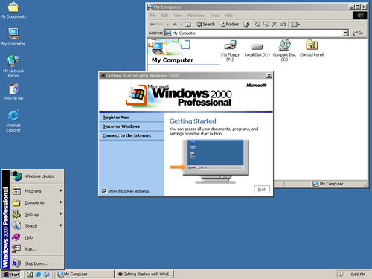
Windows 2000

Slide 17
Windows 2000 (2)
Built on NT technology
Targeted to business environments
Many server features
Active Directory
Microsoft Management Console
Encrypting File System
Dynamic Disks

Slide 18
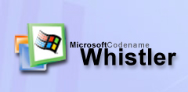
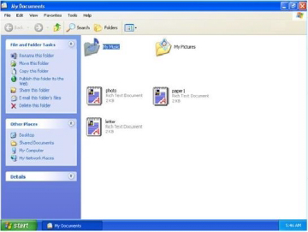
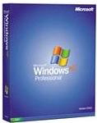
Windows XP

Slide 19
Windows XP (2)
The First consumer-oriented operating system build on the NT Kernel
Home Edition and Business Edition
New Graphical user interface
Over 400 million copies were in use in January 2006
Remote Assistance and Remote Desktop features (Only in Business Edition)
Windows Firewall
IEEE 802.11 (Wi-Fi)
.NET Framework 1.0 (13 February 2002)

Slide 20
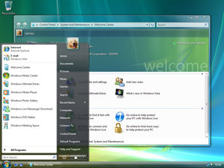
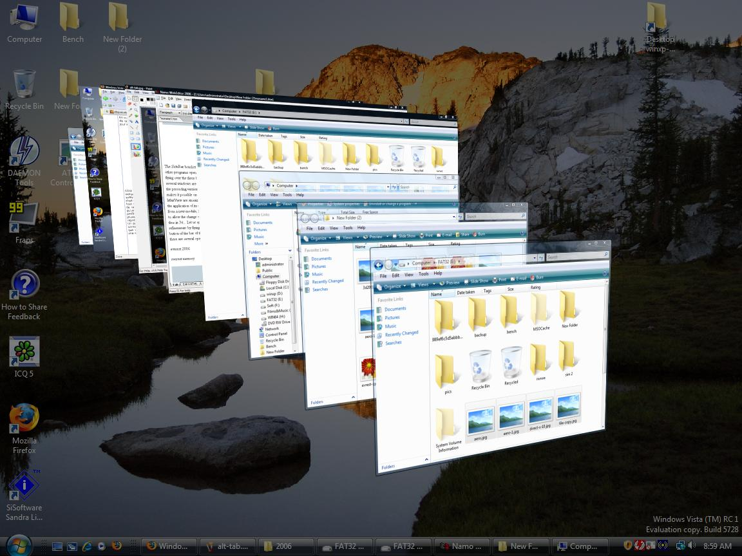
Windows Vista
New GUI and visual style Aero
.NET Framework 3.0 with many new features
Security Features:
User Account Control (UAC)
Windows Defender
Notes:
Windows Defender An antispyware program with several real-time protection agents. It includes a software explorer feature, which provides access to startup programs, and allows one to view currently running software, network connected applications, and Winsock providers (Winsock LSPs).

Slide 21
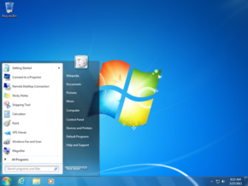
Windows 7
Software and Drivers compatibility with Vista
Multi touch support
Performance Improvements
VHD Support
Integrated PowerShell
XP Mode
Many small and large improvements over vista

Slide 22
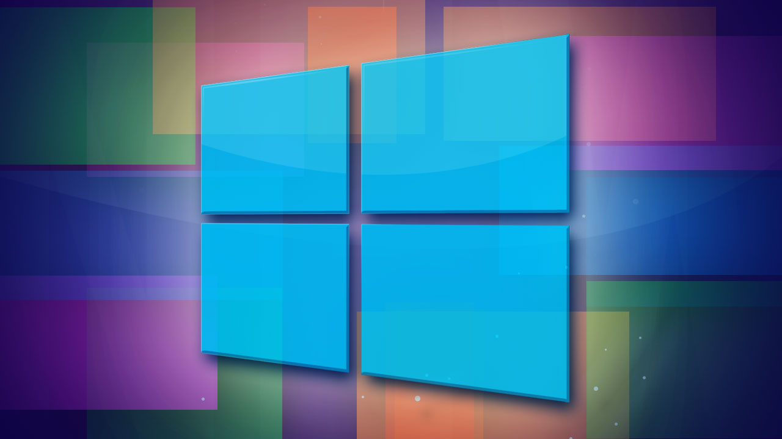
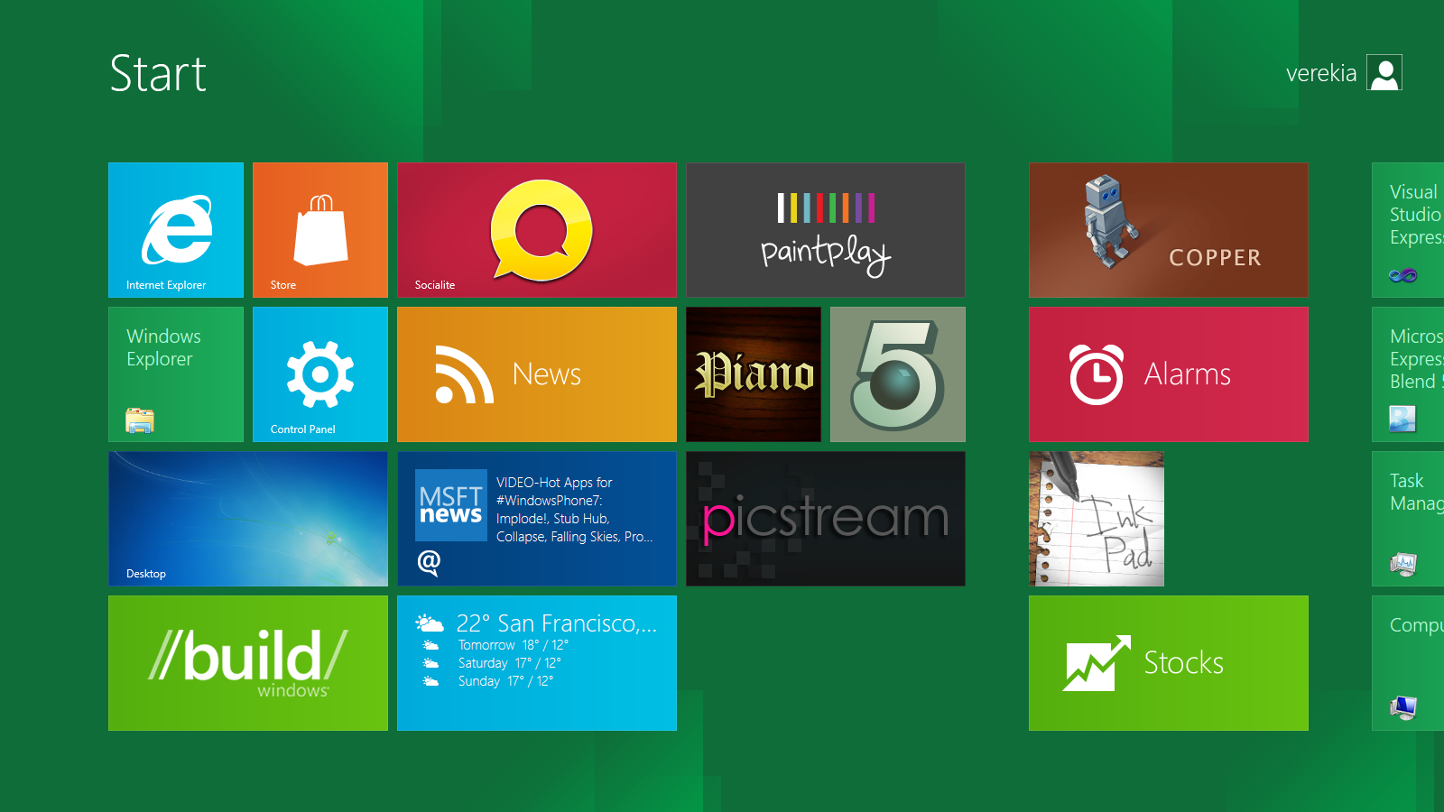
Windows 8

Slide 23
Windows 8 (2)
Significant changes to the user experience
“Metro is a key design principle for better focus on the content of applications”
Improved user experience on mobile devices
Windows Store
Supports for ARM microprocessors
WinRT
New set of APIs known as the Windows Runtime
WinRT applications can also be coded using HTML5 with JavaScript

Slide 24
Windows OS History
Domestic Use
MS-DOS
Windows 1
Server
Corporate Use
Windows 2
Windows 3
NT Server 3
Windows 3.1 and 3.11
Windows NT 3
NT Server 4
Windows NT 4
Windows 95
Windows 98
Windows ME
Server 2000
Windows 2000
Server 2003 (+R2)
Windows XP
Windows XP Home
Server 2008
Windows Vista
Windows Vista Home
Server 2008 R2
Windows 7
Windows 7 Home
Server 2012
Windows 8
Windows 8 Home

Slide 25
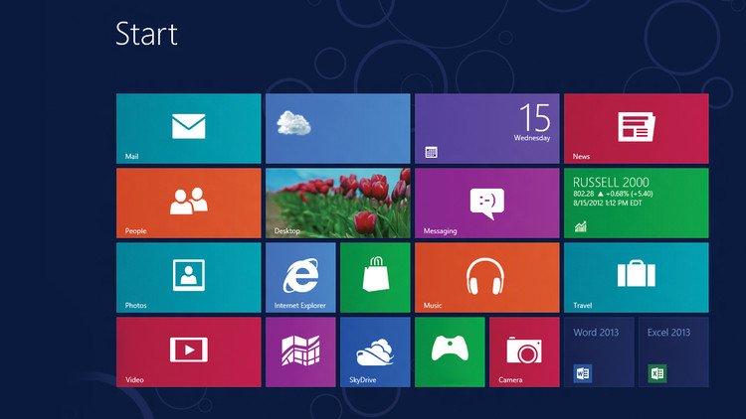
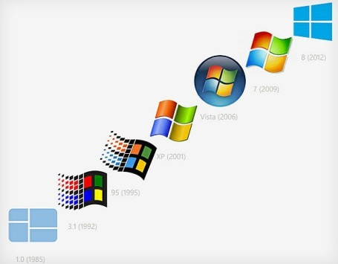
From Windows 1.0 to Windows 8.0

Slide 26
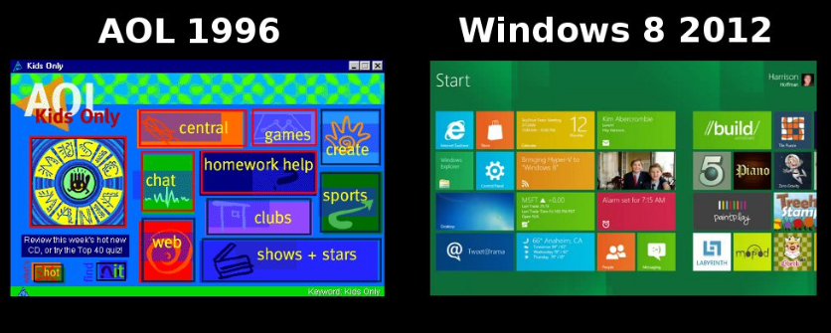
New Idea?

Slide 27
From Windows 1.0 to Windows 8.0
http://academy.telerik.com

Slide 28




Free Trainings @ Telerik Academy
"Web Design with HTML 5, CSS 3 and JavaScript" course @ Telerik Academy
html5course.telerik.com
Telerik Software Academy
academy.telerik.com
Telerik Academy @ Facebook
facebook.com/TelerikAcademy
Telerik Software Academy Forums
forums.academy.telerik.com

